Slide 1
The members of team
1 – Ahmed Salah Rady
2 – Ahmed Ibrahim Kamal
3- Ahmed Soliman Nazeer
4 – Ahmed Darwish

Slide 2
Our project about Company of programming
Departments of Company :
1 – Programs
2 - Courses

Slide 3
Programs
1 – This Department Contains about
1 – Form for Add New Data from the
employee of this Company .
2- Form for Update Ancient Data too from the employee of this Company .
3 – Form for Delete Data .
4 - Form to sale this programs .
5 – Form to sign in for Companies of client by the Client company .

Slide 4
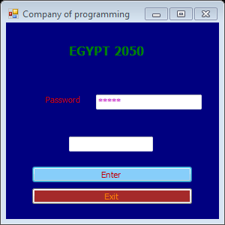
1 – Entering Form to this Company
2 – The Name of Company : EGYPT 2050

Slide 5
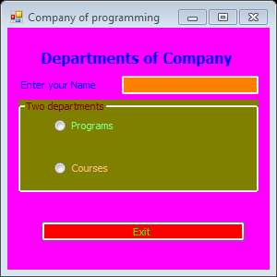
2 – Selection form between the Department of company

Slide 6
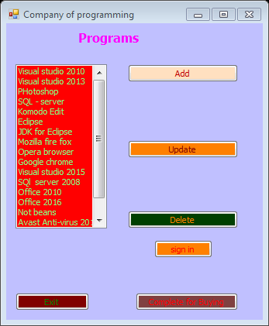
3- Programs form

Slide 7
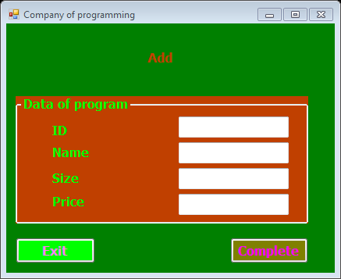
1 – Add form

Slide 8
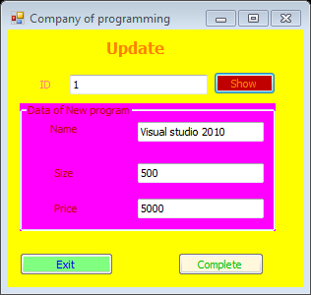
2 – Update form

Slide 9
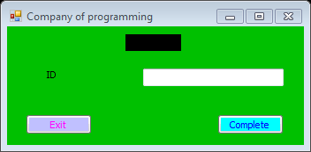
3 – Delete form

Slide 10
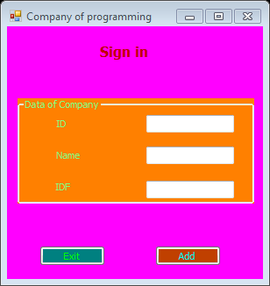
4 – Sign in form for Client company

Slide 11
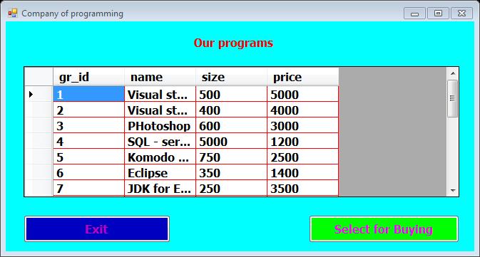
5 – Buying form

Slide 12
2 - Courses
1 – This Department contains about:
1 – Form for Add New Data for this Department .
2 – Form Update ancient Data by the employee of company .
3 – Form for Delete Data .
4 – Form for sign in in our establishment by student .
5 – Form for select the course that the student will study it .

Slide 13
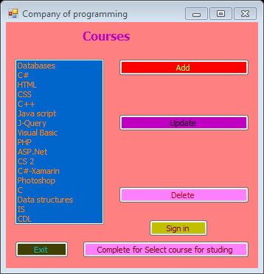
Courses form

Slide 14
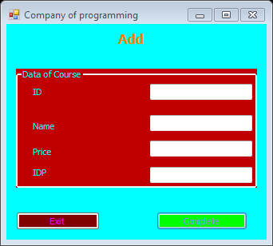
1- Add form

Slide 15
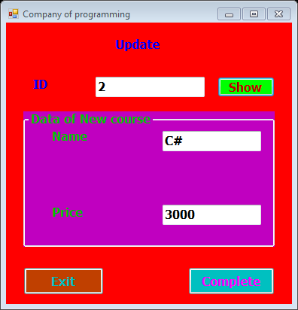
2 – Update form

Slide 16
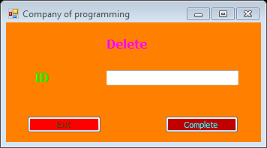
3 – Delete form

Slide 17
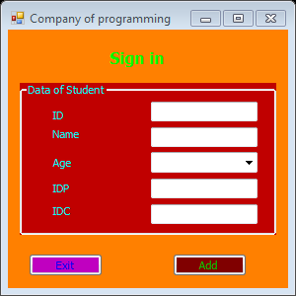
4 – Sign in form by student

Slide 18
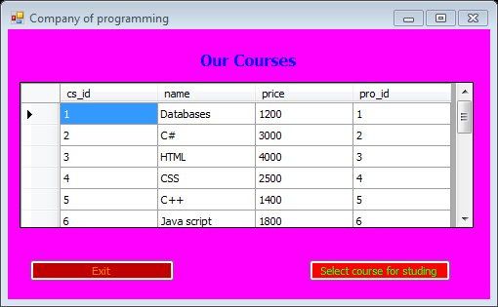
5 – Select course for studing

